Slide 1
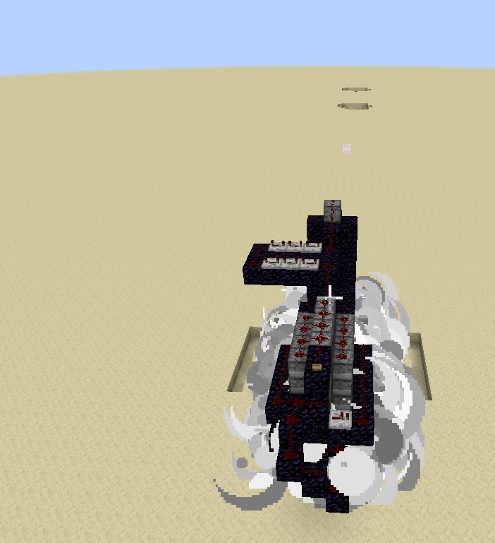
TNT Cannon
Pink wool Is a temporary block! It is used to show distance on blocks that are hard to see distance on, such as Obsidian!

Slide 2
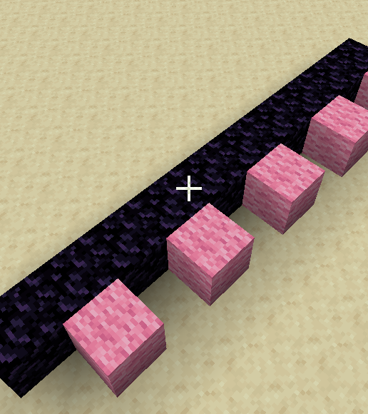
Step I
Put 10 Obsidian in a line

Slide 3
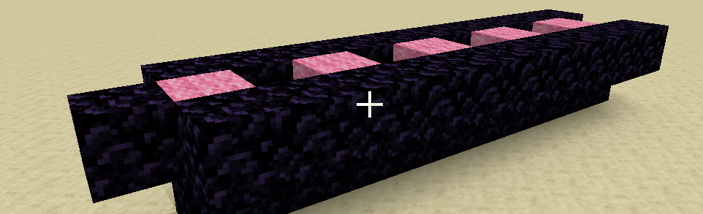
Step II
Put obsidian in a ring above the first line, leaving the front side uncovered

Slide 4
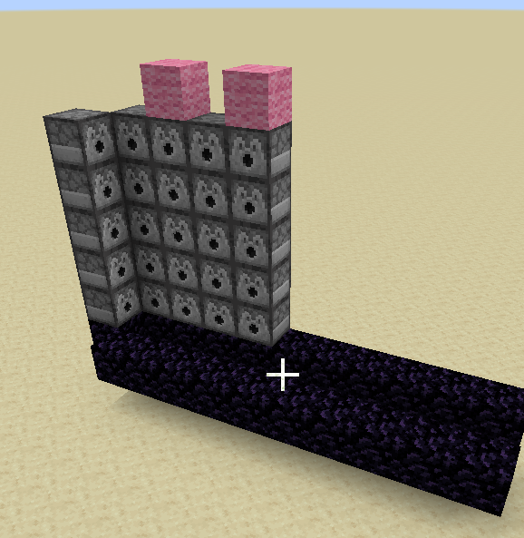
Step III
On the side with the obsidian, add dispensers on the end and the four obsidian blocks on each side.
Repeat until each stack of dispensers are 5 tall
Make sure the dispensers are facing inwards, towards the obsidian!!
Don’t forget to add them here as well!!

Slide 5
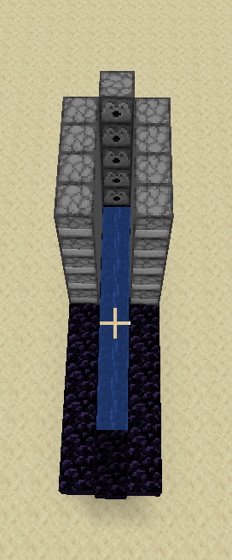
Step IV
Put a bucket of water at the end of the obsidian tunnel, on the side without an opening.

Slide 6
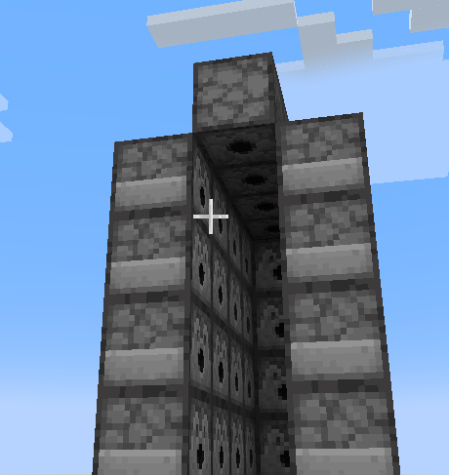
Step V
Add 4 dispensers facing downward as such to the top of the dispenser pile

Slide 7
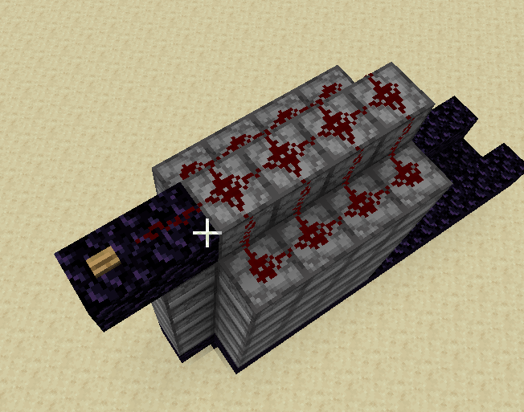
Step VI
Add the Obsidian, Redstone, and Button(any kind, your choice) to the top of the cannon

Slide 8
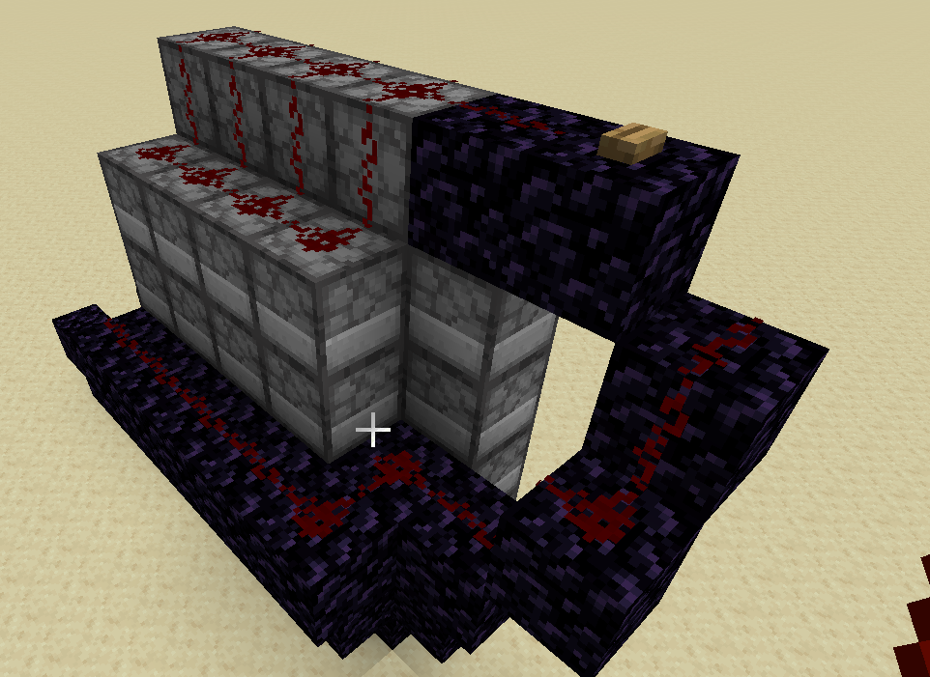
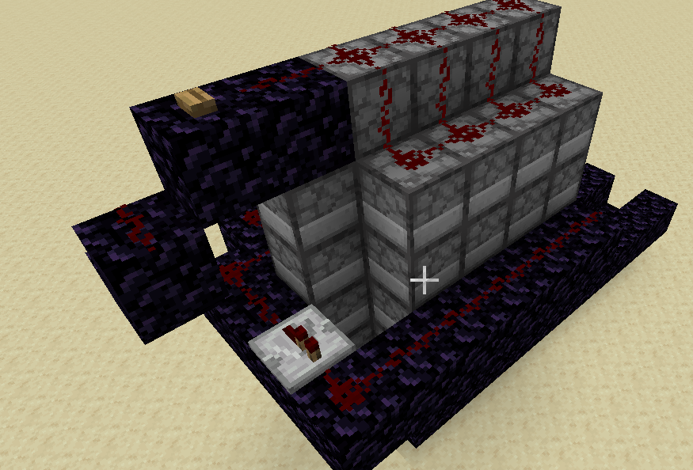
Step VII
Place the Obsidian and Redstone as shown, don’t forget the repeater

Slide 9
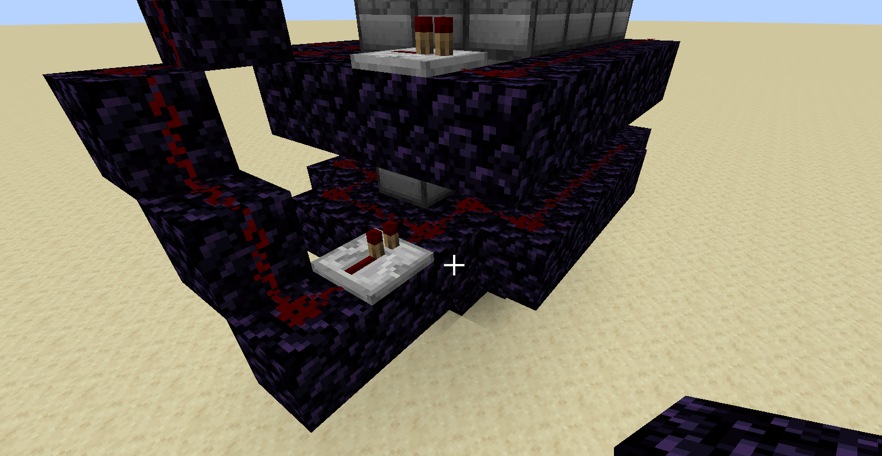
Step VIII
Add a lower ring of Redstone covered Obsidian, as shown. Don’t forget the repeater!

Slide 10
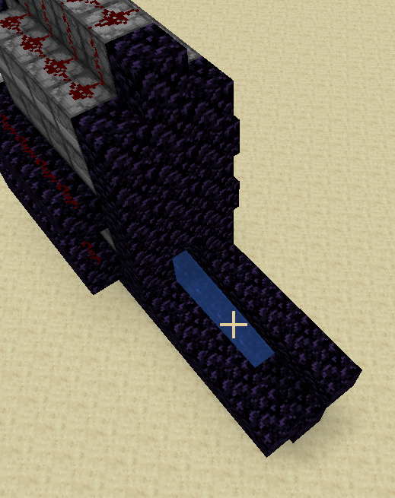
Step IX
Add obsidian to the front of the machine, leaving a hole at the bottom large enough for a player to fit through! (that includes the block that has water in it)

Slide 11
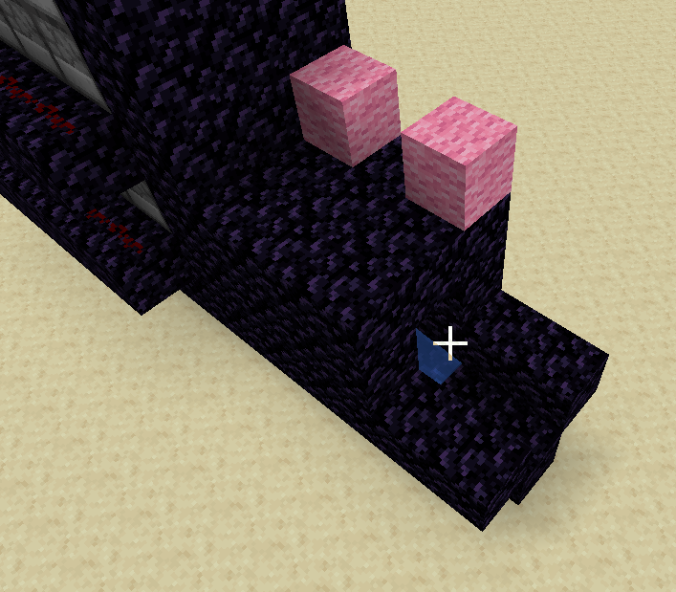
Step X
Continue the obsidian tunnel 3 blocks, it should end with 2 blocks of obsidian to spare.

Slide 12
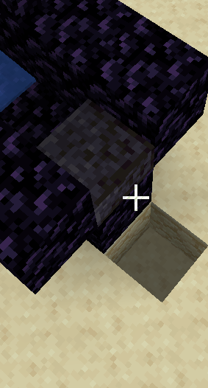
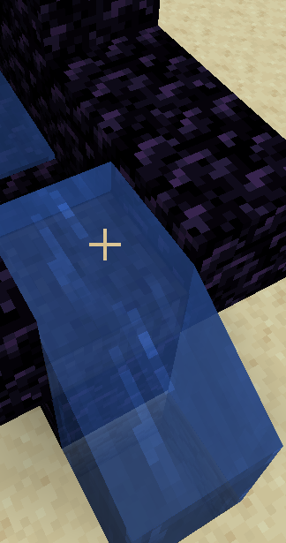
Step XI
Dig a hole and place any kind of slab you want in the positions shown, then waterlog the slab by right clicking it with a water bucket

Slide 13
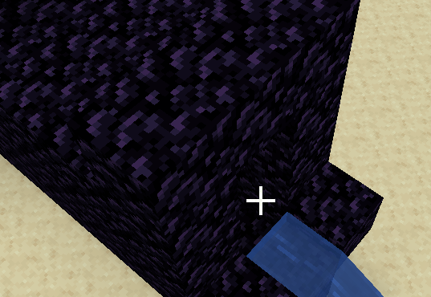
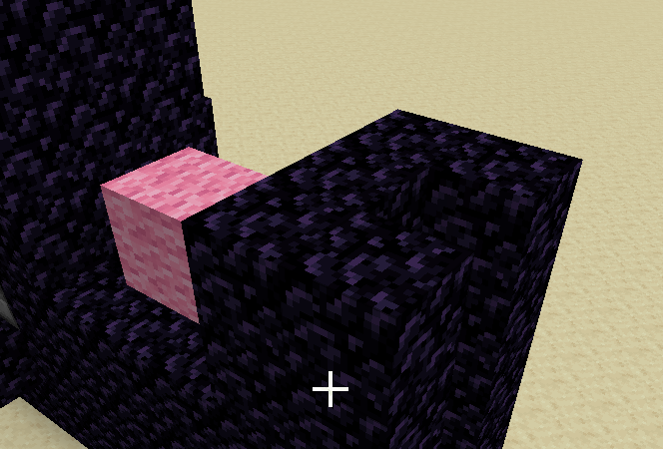
Step XII
On the second row, build a ring of obsidian that surrounds a 3 tall area (one taller than the row behind it) and then build the first and second rows up to 5 blocks tall

Slide 14
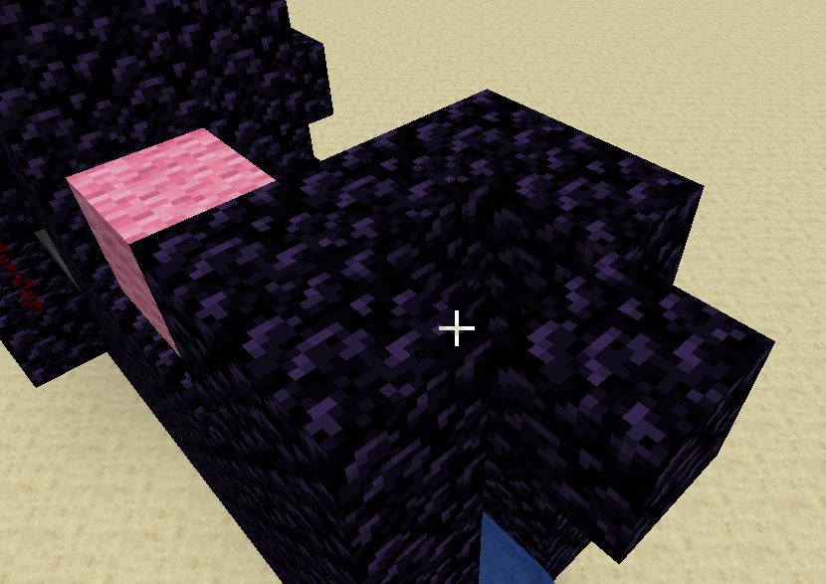
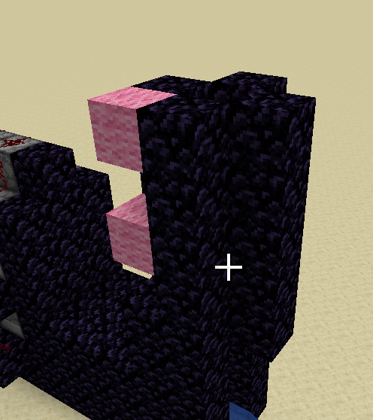
Step XIII
Put an obsidian in the spot that the image on the left shows (leaving the center an empty tube), then build it, the first row, and the second row up four blocks

Slide 15
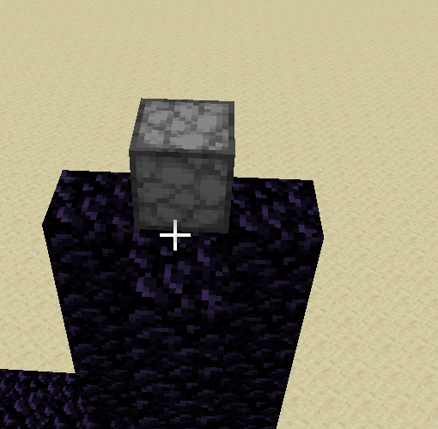
Step XIV
Place a dispenser facing down on top of the obsidian tower that you have made

Slide 16
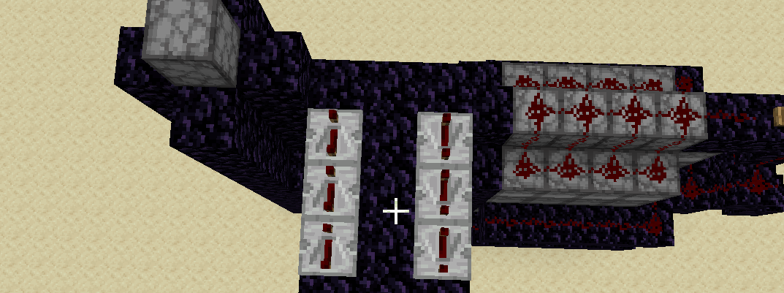
Step XV
Build a 3x5 platform as shown, then place the repeaters making sure the arrow is facing the right direction and that they are set to the position that has the two torches on the repeater as far away as possible(4 ticks, right click it to change the torch positioning)

Slide 17
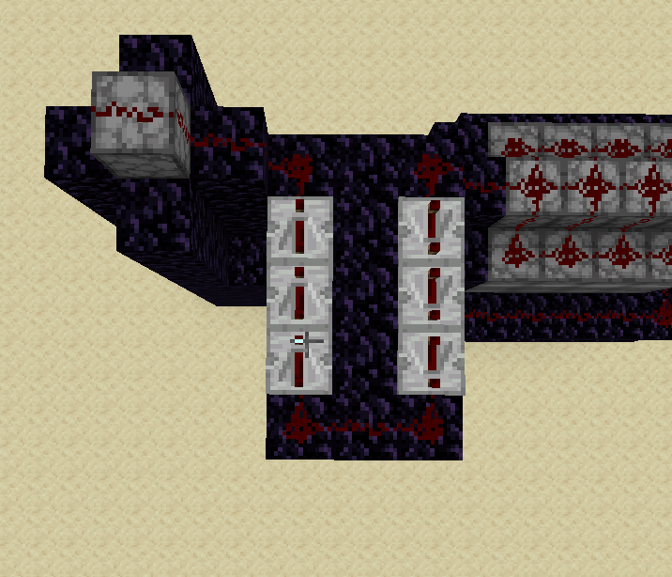
Step XVI
Place Redstone dust as shown!

Slide 18
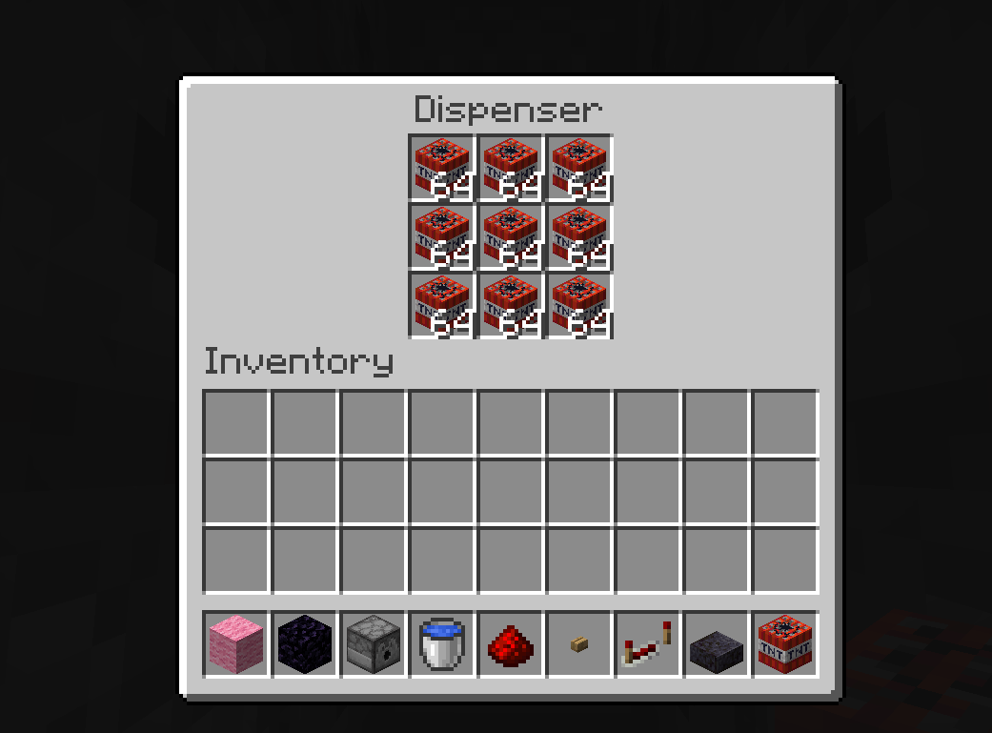
Step XVII
Go through every dispenser and fill it up!
Tip: if you middle click (press in the scroll wheel), you can get a stack of whatever item you had selected put into your hand!

Slide 19
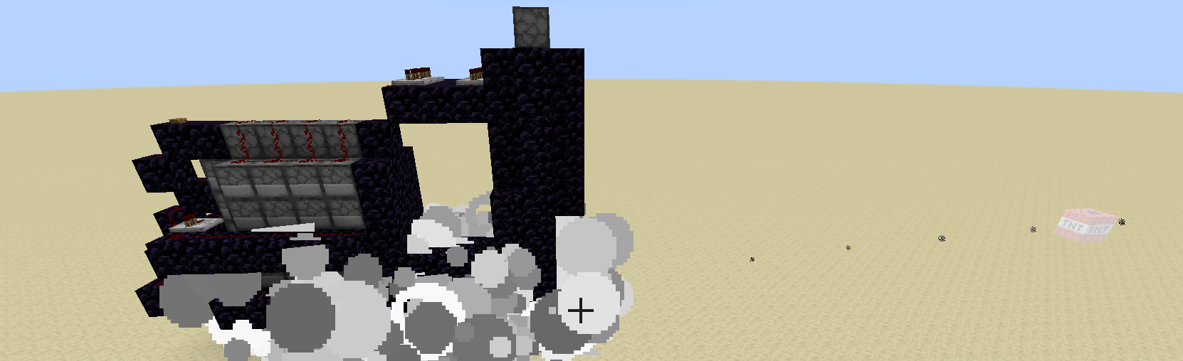
Congrats!

